Slide 1
19CSE305: MACHINE LEARNING

Slide 2
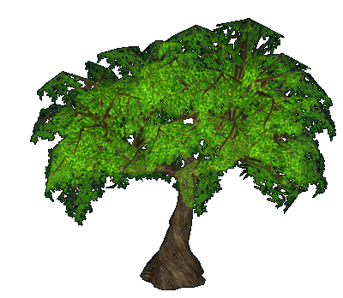
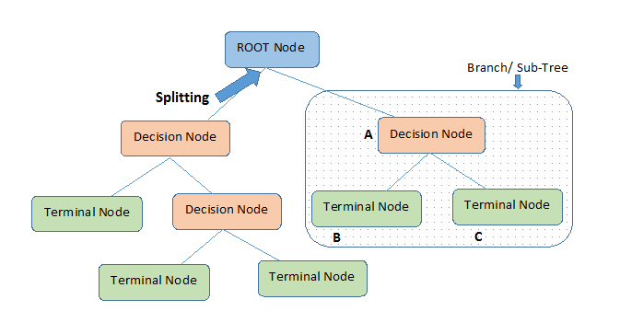
Decision Trees

Slide 3
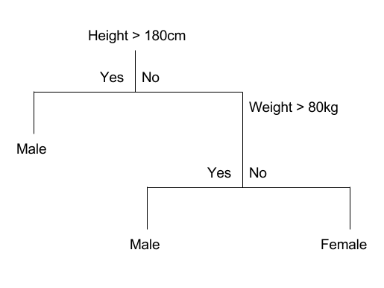
Decision Trees

Slide 4
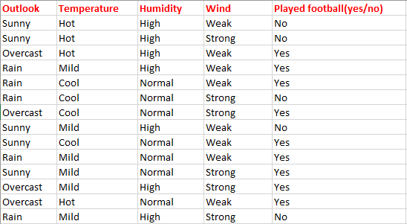
Decision Trees
Consider whether a dataset based on which we will determine whether to play football or not.

Slide 5
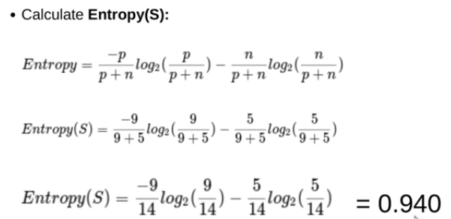
Contd…

Slide 6
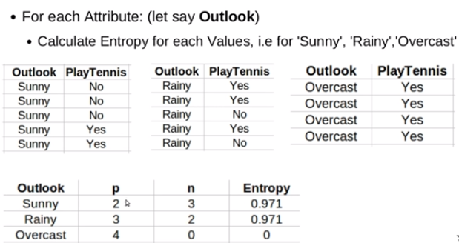
Contd…

Slide 7
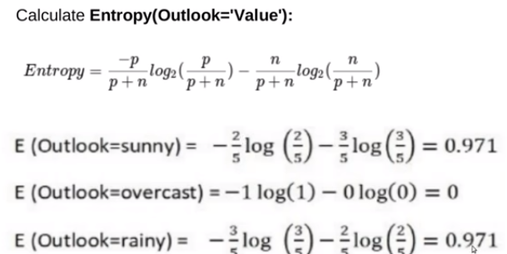
Contd…

Slide 8
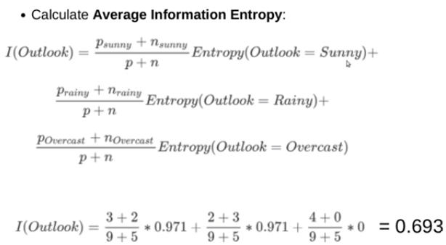
Contd…

Slide 9
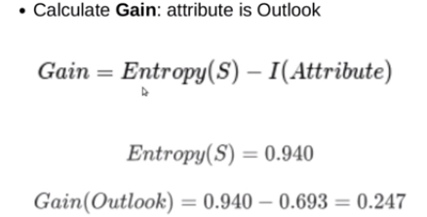
Contd…

Slide 10
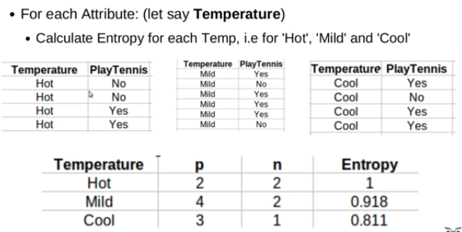
Contd…

Slide 11
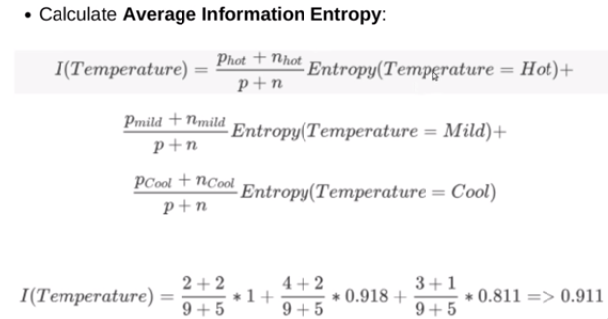
Contd…

Slide 12
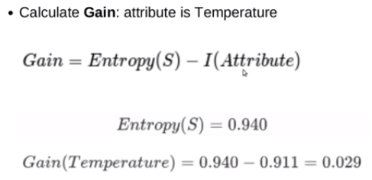
Contd…

Slide 13
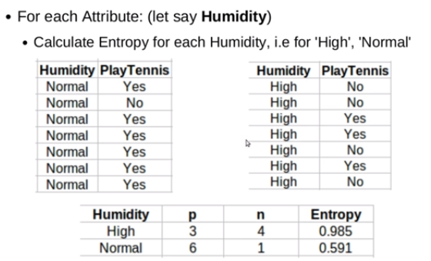
Contd…

Slide 14
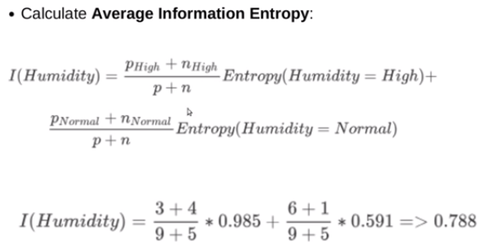
Contd…

Slide 15
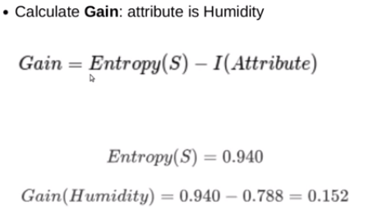
Contd…

Slide 16
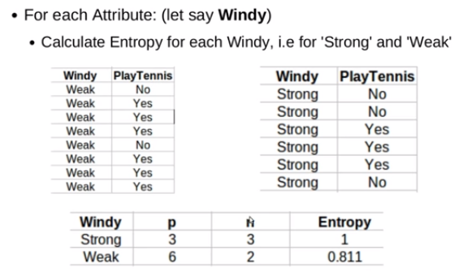
Contd…

Slide 17
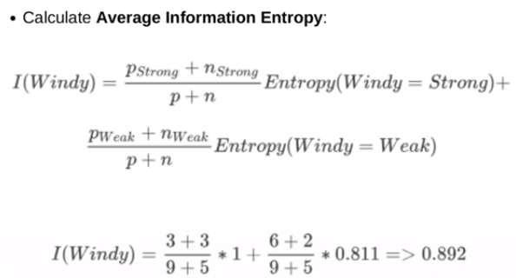
Contd…

Slide 18
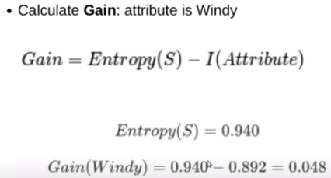
Contd…

Slide 19
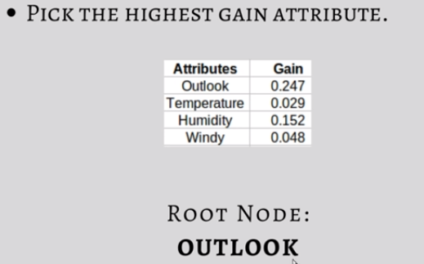
Contd…

Slide 20
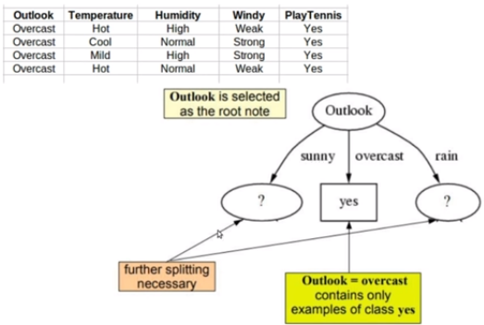
Contd…

Slide 21
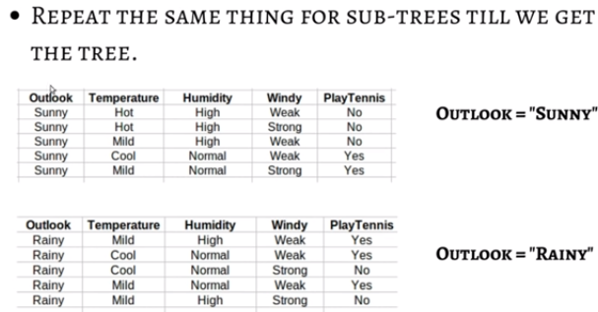
Contd…

Slide 22
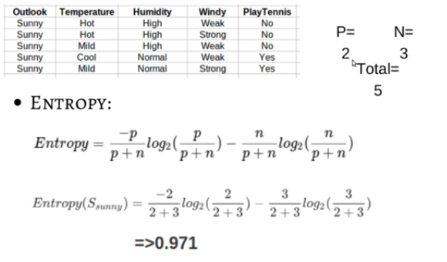
Contd…

Slide 23
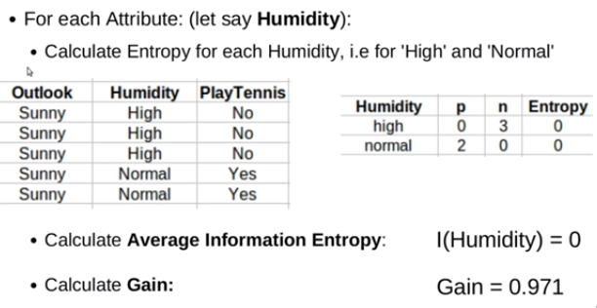
Contd…

Slide 24
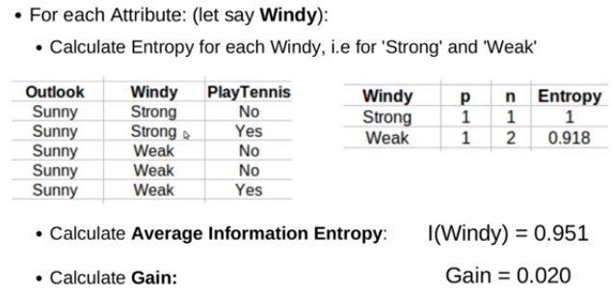
Contd…

Slide 25
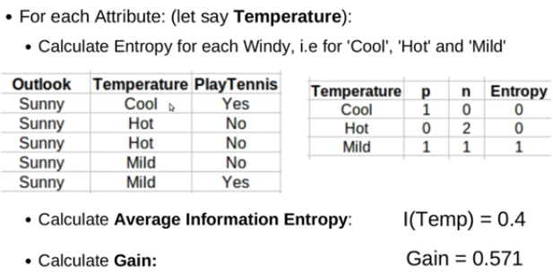
Contd…

Slide 26
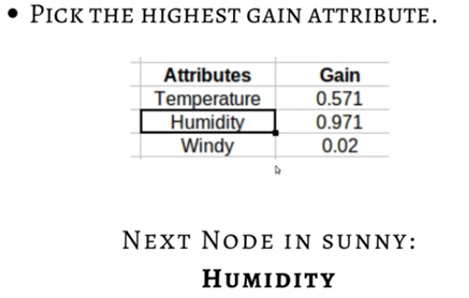
Contd…

Slide 27
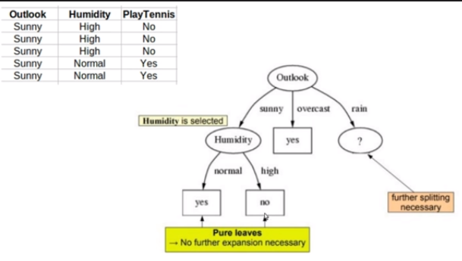
Contd…

Slide 28
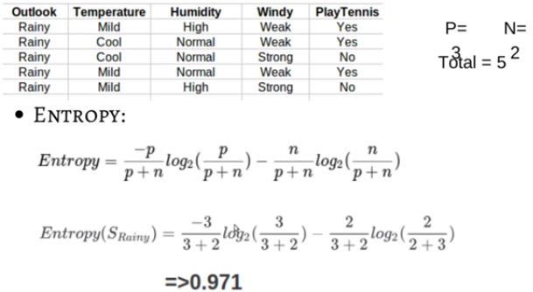
Contd…

Slide 29
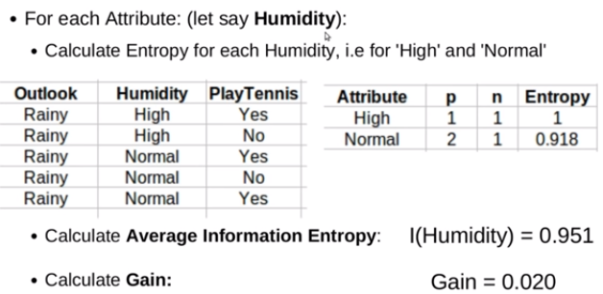
Contd…

Slide 30
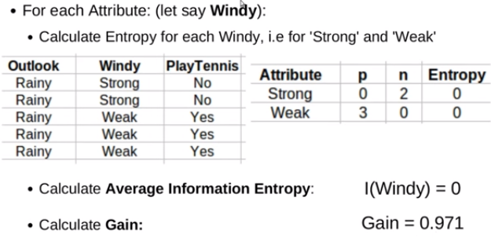
Contd…

Slide 31
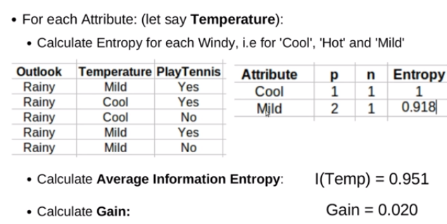
Contd…

Slide 32
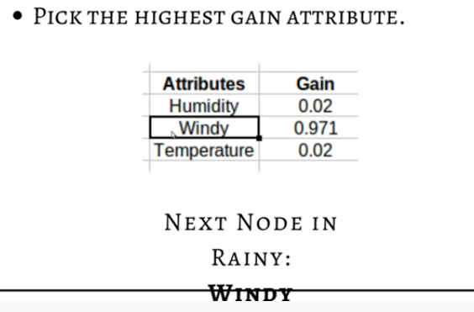
Contd…

Slide 33
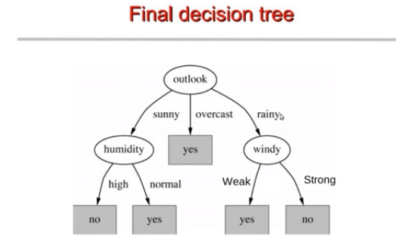
Contd…

Slide 34
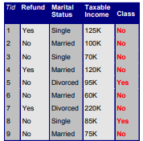
Example 2

Slide 35
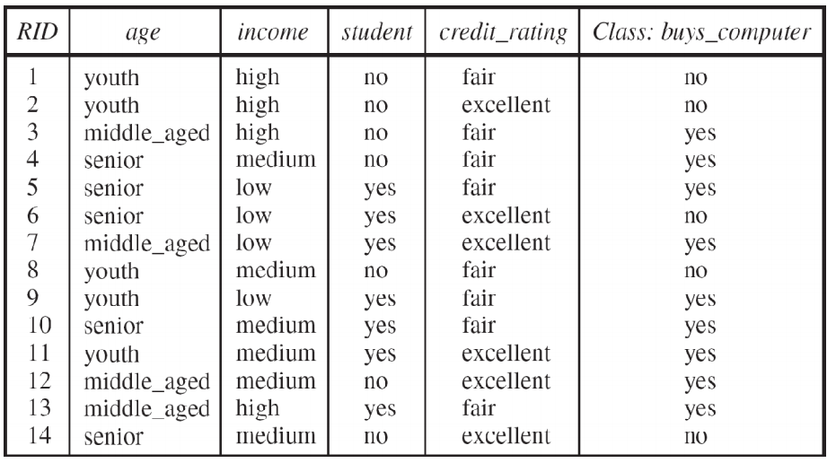
Example 3

Slide 36
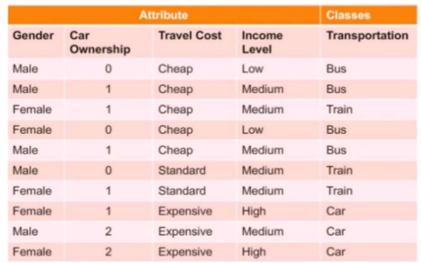
Example 4

Slide 37
Example 5
Lead Actor | Genre | Hit(Y/N)
Amitabh Bacchan | Action | Yes
Amitabh Bacchan | Fiction | Yes
Amitabh Bacchan | Romance | No
Amitabh Bacchan | Action | Yes
Abhishek Bacchan | Action | No
Abhishek Bacchan | Fiction | No
Abhishek Bacchan | Romance | Yes

Slide 38
THANK YOU

